Slide 1

Speech Emotion Recognition (SER)
Praveena Kumari Silmala
Waseema Begum

Slide 2

Objective
The intended objective of this project is to build a deep learning model that could recognize emotions in the speech we constantly exchange with one another.
Nowadays personalization is something that is needed in all the things we experience everyday.

Slide 3
Value
SER(Speech Emotion Recognition) can be used in call center for classifying calls according to emotions and as the performance parameter for conversational analysis thus identifying the unsatisfied customer, customer satisfaction and so on.. for helping companies improving their services.
It can also be used in-car board system based on information of the mental state of the driver can be provided to the system to initiate his/her safety preventing accidents to happen.
This can be used by multiple industries to offer different services like marketing company suggesting you buy products based on your emotions.

Slide 4
Relevant Work
B.J. Abbaschian, D. Sierra-Sosa, A. Elmaghraby
Sensors, 21 (2021), p. 1249
View article
Deep learning techniques for speech emotion recognition, from databases to models
M.B. Akçay, K. Oğuz
Speech Communication, 116 (2020) , pp. 56-76
View article
Speech emotion recognition: Emotional models, databases, features, preprocessing methods, supporting modalities, and classifiers
F. Andayani, L.B. Theng, M.T. Tsun, C. Chua
IEEE Access, 10 (2022), pp. 36018-36027
View article
Hybrid LSTM-Transformer model for emotion recognition from speech audio files

Slide 5

Data Preparation
Datasets
Toronto emotional speech set (Tess)
Surrey Audio-Visual Expressed Emotion (Savee)
Crowd-sourced Emotional Multimodal Actors Dataset (Crema-D)
Ryerson Audio-Visual Database of Emotional Speech and Song (Ravdess)
Data Preparation
As we want to work with four different datasets, so we will be creating a data frame storing all emotions of the data in data frame with their paths.
We will use this data frame to extract features for our model training.
Data Augmentation
Data augmentation is the process by which we create new synthetic data samples by adding small perturbations on our initial training set.
To generate syntactic data for audio, we can apply noise injection, shifting time, changing pitch and speed.
The objective is to make our model invariant to those perturbations and enhance its ability to generalize.

Slide 6
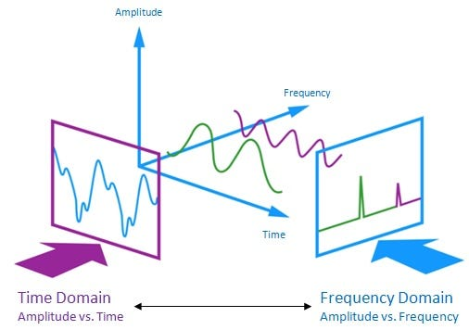
The audio signal is a three-dimensional signal in which three axes represent time, amplitude and frequency.
Feature Extraction
As data provided of audio cannot be understood by the models directly, so we need to convert them into an understandable format for which feature extraction is used.
With the help of the sample rate and the sample data, one can perform several transformations on it to extract valuable features out of it, like zero crossing rate, energy, entropy of energy, spectral centroid, spectral spread etc.
We employed following features extraction extractions on our dataframe: 'Zero Crossing Rate(ZCR)', 'Chroma Short-Time Fourier Transform (Chroma_stft)', 'Mel-Frequency Cepstral Coefficients (MFCCs)’, 'Root Mean Square (RMS) Value' and 'Mel Spectrogram’.
After that we created training data (X and Y) by appending the features of corresponding emotions. This data is converted to pandas dataframe where data manipulation and modeling is performed later.

Slide 7
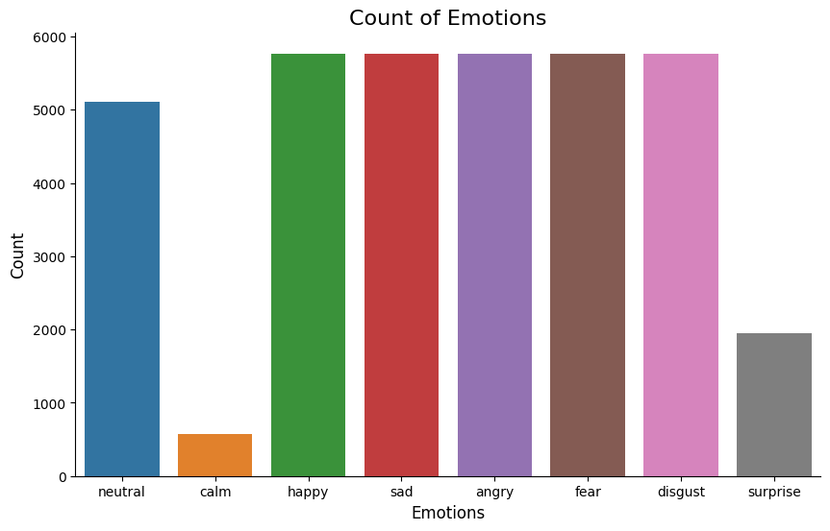
Training Data
Shape of dataframe(X, Y):
X.shape = ((36486, 162), Y.shape = (36486,))
Y is 1-D array with lables and data consists of 8 unique labels
X is 2-D array with samples generated after feature extraction

Slide 8
Data Modeling
To deal with multi-classification problem, we choose deep learning models like LSTM and CNN.
Long Short-Term Memory (LSTM) is a type of recurrent neural network (RNN) architecture designed to address the vanishing gradient problem associated with traditional RNNs.
Convolutional Neural Networks (CNNs) are a type of deep learning model designed for processing structured grid-like data.
As our dataframe had a class imbalance, we calculated ‘class weights’ based on class distribution within dataset to prevent training models overfitting to majority class.
As of hyperparameter tuning, we employed callback function as ‘Early Stopping’, and ‘ReduceLROnPlateau’ techniques. These callbacks collectively contribute to effective training by preventing overfitting (EarlyStopping) and adjusting the learning rate to navigate more efficiently towards the optimal model configuration (ReduceLROnPlateau). They enhance the model's generalization ability and stability during the training process.

Slide 9

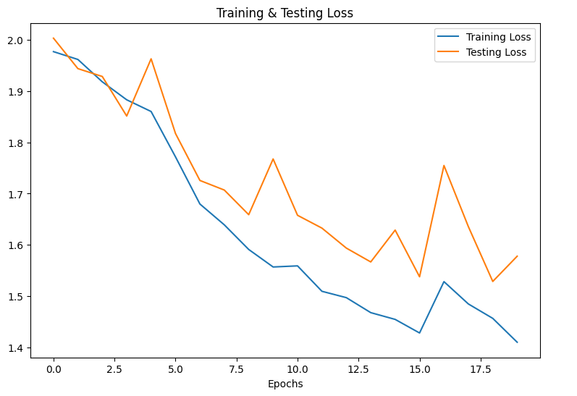
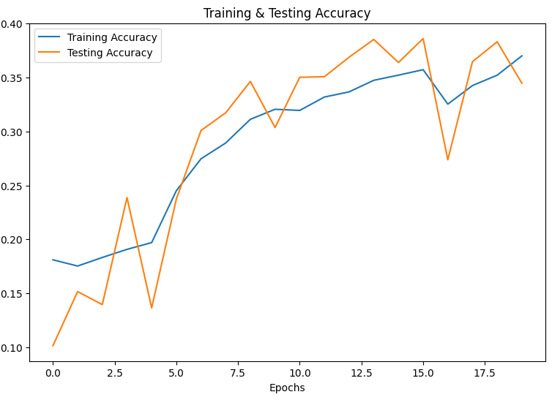
LSTM Evaluation
Training accuracy(20th epoch): 37.01 %
Validation accuracy(20th epoch): 34.48%
Testing Accuracy: 15.18%

Slide 10
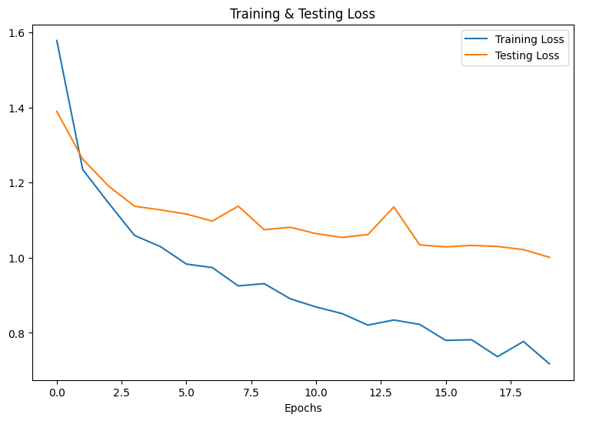
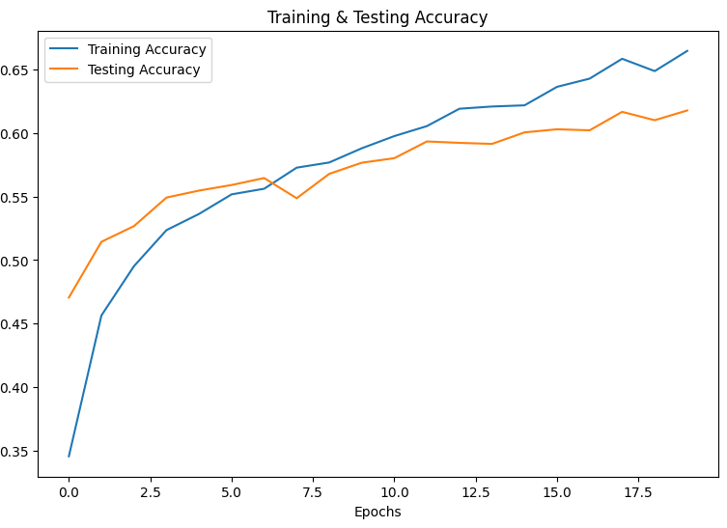
CNN Evaluation
Training accuracy(20th epoch): 66.46 %
Validation accuracy(20th epoch): 61.77%
Testing Accuracy: 62.57%

Slide 11
Deliverables
Technical report – To summarize the project's objectives, methods, findings, and outcomes.
Code - All project code and deliverables will be posted to a GitHub repository.
Video File/Link – A video group presentation will be created and posted on a platform explaining the project.

Slide 12

Thank You

